Slide 1
Family Centered Services Bidders’ Conference
Family Centered Services (FCS)
Request for Proposal (RFP) FWBP-CWP-27-001
October 27, 2025

Slide 2

Family Centered Services (FCS)
Community-based, in-home services to families involved in the child welfare system
Align with Families First Prevention Services Act of 2018
Evidence-Based Interventions (EBIs) deliver effective services statewide

Slide 3

Background
Family Centered Services started in 2020
  Continuous evaluation of strengths and opportunities
Reconfigured FCS contract
  Focus of quality services centered around parents
Prior payment methodology not meeting needs

Slide 4
Notable Changes
Shifting focus to services for parents
HHS staff focused on meeting children’s needs
Minimum of one contract per service area
Consistent service provision per service area
Increased service expectations during family interactions
Reduce administrative costs
Tiered intensity of services
Youth in Transition Decision Making (YTDM) meetings moving to the Aftercare contract
Kinship Navigation moving to the RRTS contract
Shift some services to other contracts
Reduce frustration from staff

Slide 5
Parent-Focused Services
Family Casework
Motivational Interviewing
Family Focused Meetings
Non-Agency Services
Family Preservation Services
Child Safety Conferences
Motivational Interviewing
SafeCare
Agency and Non-Agency SafeCare
Family Interactions
Post-Removal Conference Facilitation

Slide 6
Benefits for Families
Enhance warm handoffs
Increased communication with CPS staff and family
Fridge sheet sets expectations with families
Enhance access to Family Interactions
Additional interaction opportunity for multi-household families
Enhance the role of natural supports supervising interactions
Build capacity of long-term support for families
Increase family’s connections to wider community

Slide 7
Warm Handoffs
CPW makes FCS referral at day 15 of assessment
CPW and SWCM have handoff meeting with family within 2 days of assessment closing
SWCM discusses potential meeting times for the following week
SWCM and FCS have handoff meeting with family within 14 days of referral

Slide 8
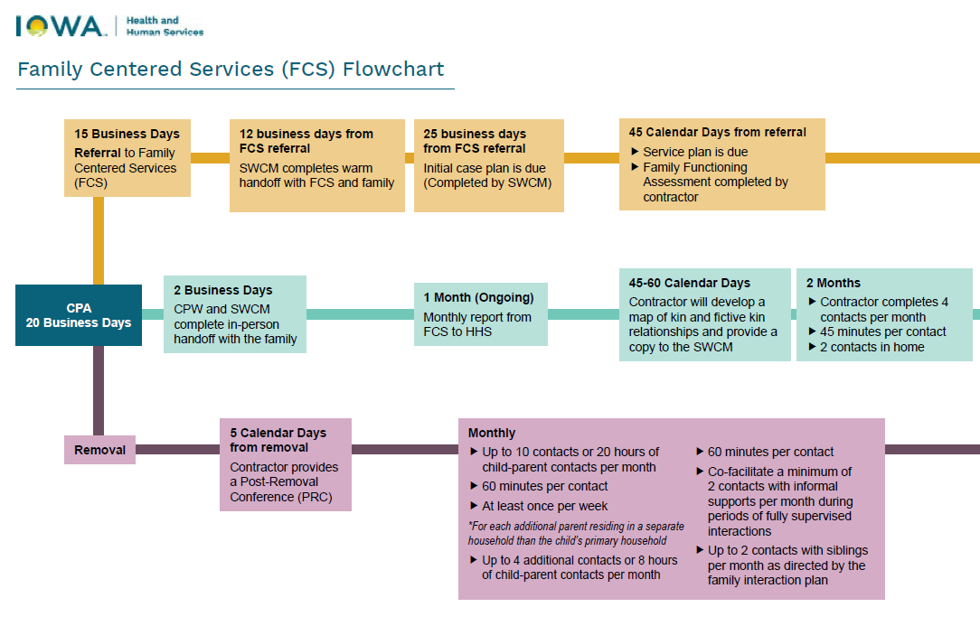

Slide 9
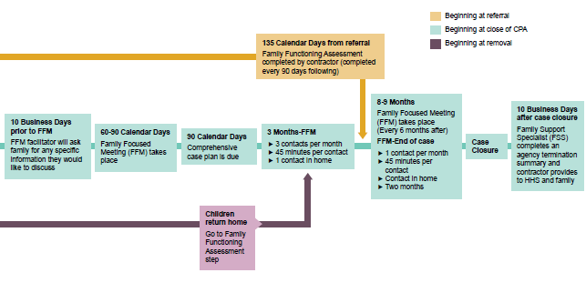

Slide 10
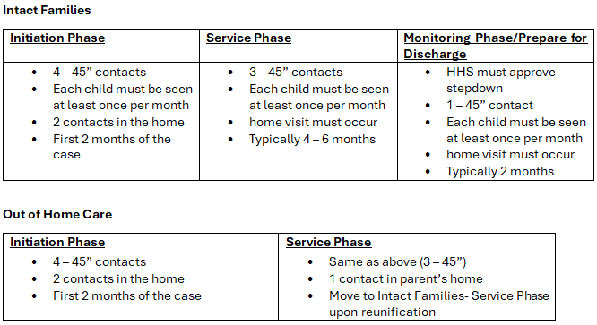
Tiered Intensity of Services
At return home
at return home

Slide 11
Intact/In Home

Slide 12

Intact Casework Contact Matrix
Initiation
  Most intensive, identifying needs and change plans
Service
  Allows family to develop/practice skills
Monitoring/prep for discharge
  Family able to demonstrate lasting change

Slide 13
Intact Family Casework Monthly Contacts
Initiation Phase | Service Phase | Monitoring Phase/ Prepare for Discharge
4 Contacts, 45 minute minimum | 3 Contacts, 45 minute minimum | HHS must approve stepdown
Each child must be seen | Each child must be seen | 1 Contact, 45 minute minimum
2 Contacts in the home | Home visit must occur | Each child must be seen
Typically first 2 months | Typically open 4-6 months | Home visit must occur
 |  | Typically 2 months

Slide 14
Out of Home

Slide 15
Post Removal Conference (PRC)
Briefly discuss reason for removal
Discuss all needs related to the child’s well-being
Scheduled appointments, allergies, medications, IEPs/504 plans, likes, dislikes and preferences
Development of the initial family interaction plan
Development of the parents’ fridge sheet

Slide 16

Casework
Contact Matrix
Out-of-Home Track
Initiation
  Most intensive, identifying needs and change plans
Service
  Allows parents to develop/practice skills
Service (in-home)
  Allows family to adjust to new routines
Monitoring/prep for discharge
  Family able to demonstrate lasting change

Slide 17
Out of Home Care Casework Monthly Contacts
Initiation Phase | Service Phase
4 Contacts, 45 minute minimum | 3 Contacts, 45 minute minimum
2 Contacts in the home | 1 Contact in parent’s home
 | Move to Service Phase in Intact Family Casework Contact matrix
 | 3 Contacts, 45 minute minimum

Slide 18
Service Plan Development
Closer alignment with HHS case plan development
Builds on document developed by the CPW and SWCM at their handoff with the family
Family functioning assessment helps target specific needs of families

Slide 19
Family Interactions
Teaching, coaching and mentoring role for providers
  Recognizing and responding to children’s needs
  Emotional regulation for parents
  Making changes that enhance child safety
Access to additional time for multi-household families
  Counted as separate referral from primary household
Natural supports supervising interactions

Slide 20
Performance Measures
Modified/added performance measures to focus on quality service provision
First year of contract will evaluate effectiveness of PMs
PMs focus on contact with families, stability of placements, and stability of the FCS program

Slide 21
Performance Measures
Family Casework
  Safe from abuse for 12 months
  Contact frequency
  Successful reunification and remaining in home for 12 months
SafeCare
  No removal in the 6 months following the end date of service
Family Preservation Services
  No removal during provision of the service or over the following 3 months

Slide 22
Performance Measures
Family Interactions
  Duration of interactions matches FIP
  First interaction within 5 days of PRC
Staff Retention
  85% staff and supervisors remain consistent

Slide 23
Payments

Slide 24
Payment Methodology
Simplified payment structure that supports workforce stability
Amounts determined based on anticipated case loads
Increased provider discretion and flexibility to meet families’ unique needs

Slide 25
Payment Structure Comparison
Current
RFP
Pay per case rate (capitation rate)
Financial instability
Outcome focused performance measures
Monthly fixed rate (firehouse model)
  Stable, professional workforce
More financial stability
Performance measures based on the totality of service provision and case success

Slide 26
Payment Structure
Stable payment per month to support maintaining stable workforce
Risk corridor is +/- 5% of caseload
Rates developed based on historical data for max caseload plus 5%
  Expect that it will be exceedingly rare for caseloads to be as high as stated
Reconciliation quarterly
  Cost reports will better inform actual service costs
Payment reductions due to poor performance
  Tied to Performance Improvement Plans

Slide 27

Administrative Costs
Capped at 15% of monthly payment
Definition of administrative costs is consistent with other HHS contracts
Transportation is not included in administrative costs

Slide 28

Concrete Supports
Cap on concrete supports- 3%
Ensure role clarity of who is responsible for what
Cap is maximum expected to be spent by contractor each month

