Slide 1
RFP0223005113 Tires, Tubes, & Services
Lead State: Iowa

Slide 2
Agenda
RFP Documents
00 – RFP Summary
01 – RFP Terms & Conditions
02 – Scope of Work
03 – RFP Evaluation Plan
04 – Sample Master Agreement
05 – Potential Participating
06 – Protest Information
07 – Offeror Information, Acknowledgements, & Certifications
08 – Offeror Response Worksheet
09 – Cost Proposal
10 – Proposed Modifications to Sample Master Agreement
11 – Claim of Business Confidentiality

Slide 3
00 – RFP Summary
Overview
Request for Proposal (RFP) is being issued by the State of Iowa in collaboration with the NASPO ValuePoint cooperative purchasing program
All NASPO ValuePoint Master Agreements
Combined spend for 2021 is $16.94 Billion
Combined spend for 2022 is 19.08 Billion
Tires, Tubes, & Services NASPO ValuePoint Master Agreements
Combined spend for 2021 is $204.48 Million
Combined spend for 2022 is $235.96 Million

Slide 4
00 – RFP Summary
RFP Contact Information – Single Point of Contact
David Kundid
David.Kundid@iowa.gov
515-745-2796
Important Dates
RFP Open Date: July 27, 2023
RFP Q&A Deadline: August 23, 2023 at 4:00 P.M. Central Time
RFP Close Date: September, 13, 2023 at 3:00 P.M. Central Time
RFP Website to Read, Review, Retrieve Attachments, Respond, & Ask Questions
Offeror shall Register with IMPACS – State of Iowa Procurement System
https://bids.sciquest.com/apps/Router/PublicEvent?CustomerOrg=DASIowa

Slide 5
01 – RFP Terms & Conditions
List of definitions
Governing law & venue
Iowa is the venue for any protest, claim, dispute, or action to RFP
Firm Offer – Offeror proposal shall be a firm offer 180 days following RFP Close Date

Slide 6
02 – RFP Scope of Work
Tires and Tubes Subcategories
Pursuit & Performance Tires: Police & other pursuit vehicles
H, V, W, Y, or ZR rated or above
Automobile/Passenger Vehicles: Common passenger vehicles
Designated with a “P” at the beginning of the tire size
Light Duty Trucks Radial & Bias: Pickup trucks, SUVs, vans & some trailers
Designated with a “LT” at the beginning of the tire size
Medium Commercial/Heavy Duty Trucks/Buses: Medium and heavy duty trucks, buses, semi-trucks, cargo vans, and some trailers
Subcategory has a diameter equal to or greater than twenty (20) inches
Off-the-Road (OTR) and Low Speed Off Highway Tires (Radial & Bias): Heavy construction equipment such as wheel loaders, backhoes, graders, & trenchers

Slide 7
02 – RFP Scope of Work
Tires and Tubes Subcategories
Agricultural/Farm (Radial & Bias): Farm tractors, wagons, harvesters, & other farm implements
Industrial: Specialty industrial equipment, some construction equipment such as forklifts and skid loaders
Specialty Tires: ATV, UTV, recreational, & aviation
Electric Vehicle (EV) Tires: Electric vehicles
Retread (Optional): Worn tread replacement on used tires

Slide 8
02 – RFP Scope of Work
Services Specifications
Tire installation
Change tire, dismount, & mount
Flat repair, remove, repair, & mount
Flat repair, off vehicle
Route mounted tires
New valve stem rubber or metal
Wheel balance
Foam filled
Alignment services
Studding
Siping
Disposal
TPMS

Slide 9
03 – RFP Evaluation Plan
Mandatory Minimum Specifications
Offeror’s Proposal will be rejected if the Offeror fails to state they meet all Mandatory Minimum Specifications
Technical Criteria
Total possible points is 700
Offeror’s Proposal shall be rejected if the Offeror fails to earn a minimum of 400 points
The Cost Proposal shall only be opened for an Offeror’s Proposal that earned a minimum of 400 points

Slide 10
03 – RFP Evaluation Plan
Cost Proposal
Total possible points is 300
Market Basket Categories
Pursuit and Performance Tires
Automobile/Passenger Tires
Light Duty Trucks
Medium Commercial/Heavy Duty Trucks/Buses
Market Basket for each category shall be ranked from least to most expensive
Least expensive for each category shall receive maximum number of points available
To determine the number of points to be awarded to all other Cost Proposals, the least expensive Cost Proposal will be used in all cases as the numerator. Each of the other Cost Proposals will be used as the denominator.

Slide 11
03 – RFP Evaluation Plan
Award Selection
Multistate Sourcing Team will evaluate which Offerors Proposal shall be awarded
Lead State presents award recommendations to NASPO ValuePoint Executive Council. Executive Council will review and provide approval
Notice of Intent issued to all Offerors by email notification from RFP Contact

Slide 12
04 – RFP Sample Master Agreement
Initial Term
Three (3) years with three (3) additional one (1) year renewal options
Pricing
All prices & rates guaranteed for a six (6) month term
Proposal prices & rates shall be guaranteed from 4/1/2024 – 9/30/2024
Master Agreement allows for a price increase every six (6) months
Payment terms
NET sixty (60) days Per Iowa Code 8A.514
Participant Participating Addendum
Each participant may propose additional terms & conditions in addition to Master Agreement terms and conditions

Slide 13
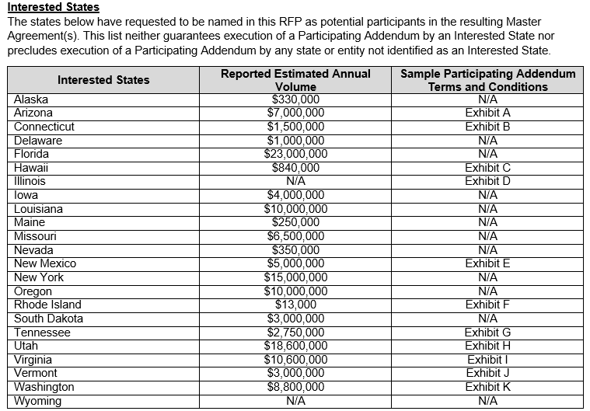
05 – RFP Potential Participation

Slide 14
06 – RFP Protest Information
The notice must be filed within five (5) days of the date of the Notice of Intent to Award issued by the Iowa Department of Administrative Services, exclusive of Saturdays, Sundays, and legal state holidays.
Email written notice of appeal (in accordance with 11-Chapter 117.20, Iowa Administrative Code) to the Director of the Department of Administrative Services and carbon copy to the to the RFP Contact

Slide 15
07 – RFP Offeror Information, Acknowledgements, & Certifications
Offeror information
Business details
Proposal contact

Slide 16
08 – RFP Offeror Response Worksheet
How to Respond
Clearly mark Solicitation Number RFP0223005113 on all materials
08 – Offeror Response Worksheet
Confirm Offeror can meet mandatory minimum requirements in Section 1
Answer the technical questions in Section 2

Slide 17
09 – RFP Cost Proposal
1. Product Price Discounts
Enter percentage off list price for each applicable category
2. Service Rates
Enter service rate for each applicable category
3. Market Basket
Enter service rate for each applicable category
4. Multi-State Alignment Hourly
Enter fixed hourly labor rate for each state
5. Multi-State Tire Disposal
Enter tire disposal fee for each state

Slide 18
10 – RFP Proposed Modifications to Sample Master Agreement
Offeror may propose modifications to the Sample Master Agreement

Slide 19
11 – RFP Claim of Business Confidentiality
Offeror shall state if they have confidential, proprietary, or protected information
Offeror shall submit a Pubic Proposal & Confidential Proposal with their proposal if there is confidential, proprietary, or protected information

Slide 20
Thank you for attending.
Do you have any questions?

