Slide 1
Core functions of system
Account management – high level to low level similar to online banking, with more robust data sets
System must communicate with the state’s I-3 accounting system
System must be able to generate canned letters and reports
Users must be able to develop ad hoc reports
Needs to be expandable – As new programs are funded/created
Provide platform for Electronic signatures or authorization
When new vendor/applicants are being entered, have the address validated against I-3.
User interface must be simple and easy to navigate – desktop and smartphone compatible
Mapping – GIS mapping component capable of linking to other systems

Slide 2
MANAGE LINE OF BUSINESS AND STATE ACCOUNTS
Line of Business and Sub Accounts Created by high level user – Line of Business is Associated with Defined I3 Cost Center.
Account A
Line of Business (Cost Center 1)
Account B
Line of Business (Cost Center 2)
Line of Business (Cost Center 3)
Account C
Account D
Account E
Account F
Account G

Slide 3
MANAGE DISTRICT ACCOUNT and REGIONAL ACCOUNTS
Created by high level user – select one to many counties associated with a district/regional account
High Level Accounts
(District)
High Level Accounts
(District)
Associated County
High Level Regional Accounts
(District)
Associated County
Associated County
Associated County
Associated County
Associated County
Associated County

Slide 4
MANAGE USERS
Users associated with district and regional accounts are created by high level users. These users can be associated with one to many district accounts/regional accounts.
User “A”
User “B”
User “C”
User “D”
High Level Accounts
(District)
High Level Accounts
(District)
Associated County
High Level Regional Accounts
(District)
Associated County
Associated County
Associated County
Associated County
Associated County
Associated County

Slide 5
MANAGE PRACTICES
Practices are created by a high level user and associated with district and regional accounts. These users can be associated with one to many district accounts/regional accounts.
Practice Name Associated with
One to Many Sub-Accounts
Examples
Practice Name
Expense Category
Cover Crops
Management
Practice Name
Expense Category
No-Till
Management
Sub Accounts
Practice Name
Expense Category
Terrace
Permanent
Sub Accounts
Practice Name
Expense Category
Salary
Personnel

Slide 6
Line of Business
State Account
State Account
Sub Account 1
Obligation $ to private account holders
Conservation work complete, triggers claim payment to private account
High Level Accounts (Regional Unit)
Sub Account 2
Sub Account 3
Private people apply for grants
Actual debit of district account and credit of farmer account – this action is initiated by the user of the district account. Note this action changed the “pending” to paid and the difference between the “pending” amount to the amount actually paid remains in the district account.
Line of business and state accounts need to match up with cost centers to communicate with I/3.
Debits and credits need to be able to move to/from accounts in both directions.
High Level Accounts
(District)
Like a pending debit or credit that hasn’t cleared, except the amount may change when payment is made. Also the pending amount could change.
System Users
State (full access) debit and credit transfers to district accounts and privileges in all district.
District/Regional Account (access to district/regional accounts) debit and credits within district accounts
Private Users (access to applications)
Could be 1 year from obligation date to claim paid

Slide 7
Financial Accounts
Line of Business
(example – IFIP)
Create, remove, hide
Establish state level account or accounts within line of business
Deposit, withdraw, transfer funds
State Account
(example – Cost Share, Cost Share Supplemental, Mandatory, Reserve, SSWQ Grants)
Create, remove, hide
Establish high level account or accounts within line of business
Deposit, withdraw, transfer funds
High Level User (access to all accounts) Also responsible for establishing district / regional users.
Debits and credits need to be able to move to/from accounts in both directions. These actions can only happen within the line of business. Date/time stamped.
High Level Accounts (District or Regional Unit)
example - Cost Share, POL
Create, remove, hide
Establish high level account or accounts within line of business
Deposit, withdraw, transfer funds
Working Accounts
Create, remove, hide
Establish high level account or accounts within line of business
Deposit, withdraw, transfer funds

Slide 8
Sub-Accounts
Sub Accounts
Account transactions managed by district(s) / regional user(s)
Obligate funds to end user(s) - like a pending debit/credit
Requires inputs/levels of approval
Applicant, Authority, Technical
Expend funds (claim processed and paid)
Requires inputs/levels of approval
Applicant, Authority, Technical
District/ Regional Users (access to sub accounts only – one to many)
Apply for Funds
May complete grant application on behalf of individual user
Claim Paid When Project is Complete
Private people apply for grants
Individual User (individual account access only)

Slide 9
Sub-Accounts
Private people apply for grants
Enter Data - Who, What, Where, When, $
Submission of requests that will become an application. Application status is managed by higher level users. Could be:
Pending
Status varies based on level of completion and action items by district/regional user
Funds Obligated
Status varies based on level of completion and action items by district/regional user
Expenditure of Funds
Requires inputs/levels of approval
Applicant, Authority, Technical
Individual User (individual account access only)
Vender validation, verification or creation
Conservation work complete, triggers claim payment to farmer account

Slide 10
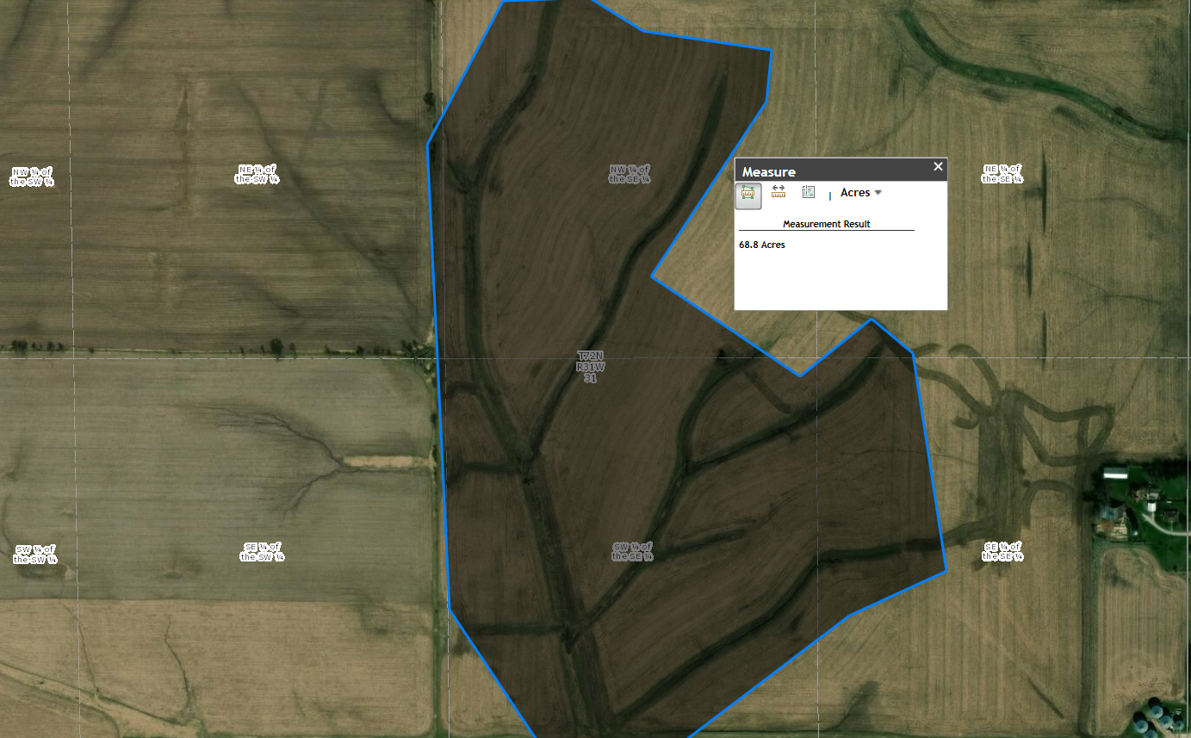
Mapping/Location Services

Slide 11
Individual or business submits application
District or Regional User receives application and completes/verifies remaining fields. Approval or review of technical aspects of project / cost estimate
Assign / Verification of sub account (program) by district or regional unit
Final approval by district or regional unit
Funds Obligated
Work complete and data is entered into system by district or regional unit
Individual or business reviews data entered by district or regional unit
District or regional unit approves claim for payment
Funds show as spent and claim is paid (connection to state I3 system)

