Slide 1
Choose Iowa Website RFP​
Dec. 14, 2022, Vendor Consultation​
IDALS Team:​
Jon Koele, Accounting​
Tim Champion, IT​
Colin Tadlock, Administration​
Alex Rausch, Communications​
Beth Romer, Choose Iowa Program​

Slide 2
Choose Iowa program overview
Statewide branded marketing program: Connect consumers to Iowa grown and processed foods and produce​
Participants featured on website; Consumers search for participants or by category​
+Marketing and Promotional Grant program​
2nd year of grant funding​
Grant applicants do not need to be current Choose Iowa participants to apply for grant funding​
Target rollout for branded marketing program = early 2023​
Will include website launch, social media​

Slide 3
Website capabilities/​features to include​
General information pages (static): ​
Homepage, About, Contact, Participant Benefits, Grant Overview​
Key sections (dynamic): ​
Participants (Find Local), Events, Recipes, What’s in Season​
Forms/Portals: ​
Become a Participant/Renew Annual Participation, Grant Application Portal, Upload/submit Coloring Calendar artwork​
Internal to participants: submit a recipe, submit an event, renew​
Participant login (submit recipe/event, update profile, renew)​
Administrative back end​

Slide 4
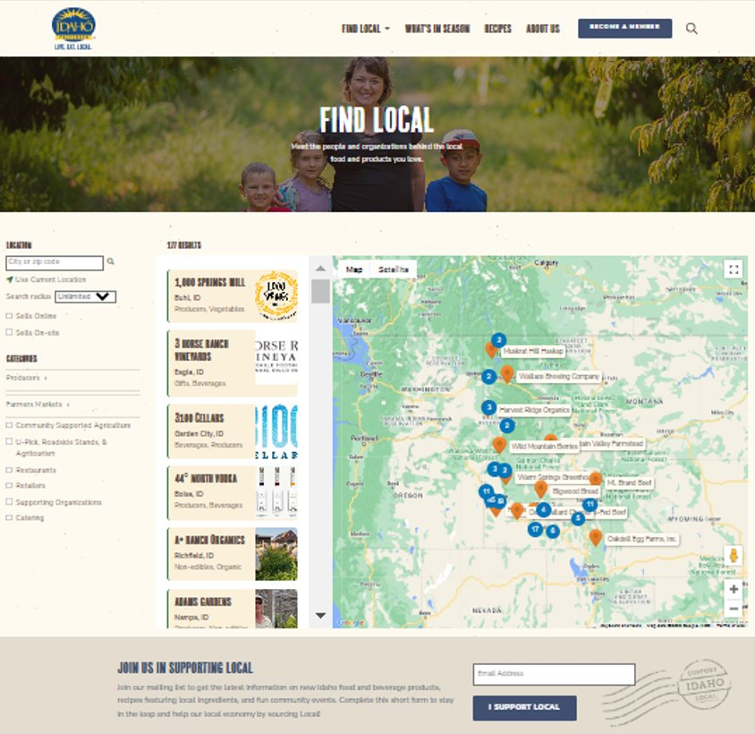
Example website
Idaho Preferred: idahopreferred.com​
What we like:​
Find Local – Dynamic mapping page; Filter participants by multiple categories​
What’s In Season​
Recipes section​
Online participant application; Accept payment for annual fees online​
Calendar of events (participants can submit events for inclusion)​

Slide 5
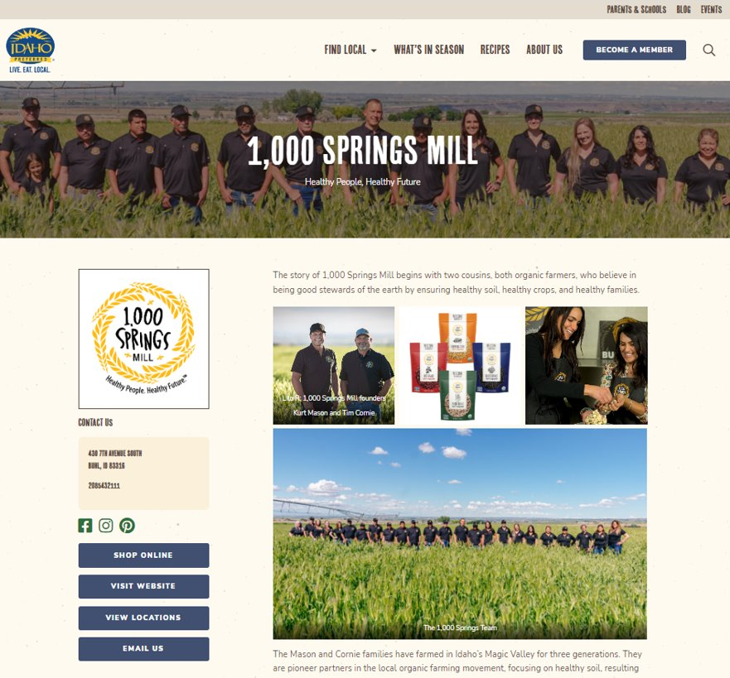
Example: Participant profile
Participants will customize their profile with their story including photos, plus add or submit:
Logo
Contact information
Social media accounts​
Online store link​
Website URL
Location addresses
Upcoming events (also include on overall calendar of events)
Recipes

Slide 6
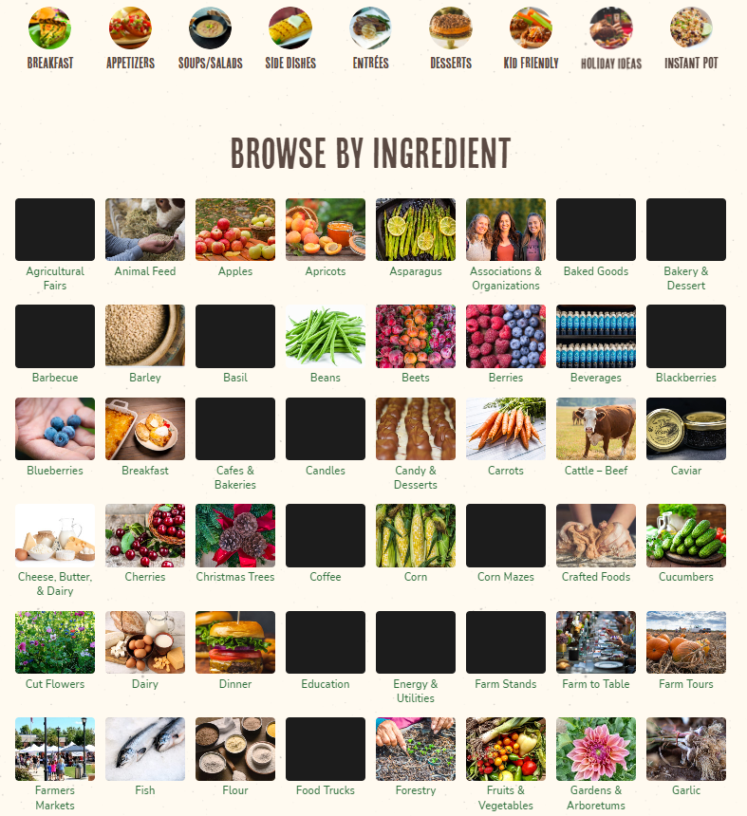
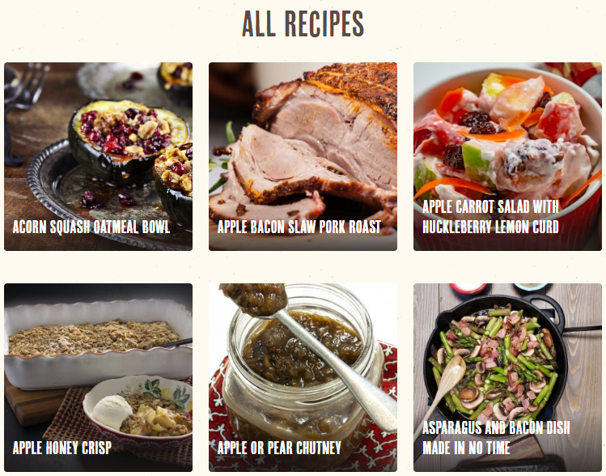
Example: Recipes
Multiple ways to access:
Featured recipes at top of page (not shown)
Browse by ingredient
All recipes load while scrolling down page
Participants submit recipes or admin can add recipes; Viewable after admin review and approval

Slide 7
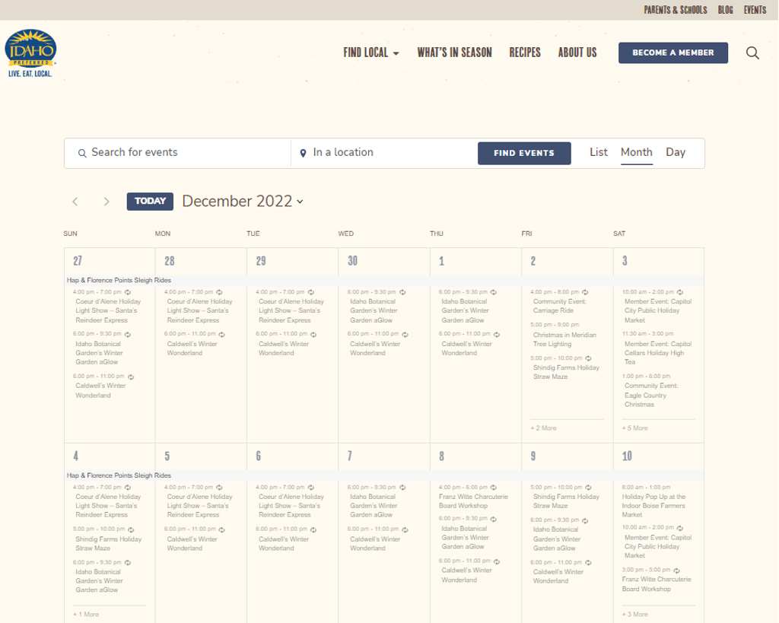
Example events page
Participants submit upcoming events for review
Admins review submitted events
Approved events appear on both Events page and participants’ profiles

Slide 8
Technical overview
Hosting
Payment portal
Email integration
Iogin authentication​

Slide 9
Hosting
IDALS uses Dreamhost as their hosting provider. Microsoft Azure is available if the technology stack on Dreamhost does not match your technology stack.​
If you use Dreamhost, IDALS will provide an account on DreamHost, and you will develop and implement there.​
If a CMS is used, it must be one approved by OCIO​
Drupal​
DNN​ (formerly dot-net nuke)
https://ocio.iowa.gov/web-content-management-system-standard​
If you chose not to use a CMS, another option is to use some of IDALS’ existing code-base written in PHP​ with a MySQL database
IDALS uses Bootstrap & jQuery in the current code-base. Although this is not required, it may speed up your development time.​

Slide 10
Payment portal with US Bank
Fee Code for the program will be provided from Finance​
IDALS integrates with US Bank​
There is a document from OCIO that outlines payment portal integration​
The general process is​
A set of data is sent to US Bank via a form post that includes the fee code, amount, and a customer ID in addition other data​
US Banks handles all the payment and security​
When the payment is successful, US Bank replies to a callback URL with the results of the transaction.​

Slide 11
Email integration
IDALS is using Exchange online​
IDALS IT has created an integration with Exchange using PHP. This integration is available for use, or as a pseudo code template for you to replicate.​

Slide 12
Login authentication
Internal Users
IDALS IT has already created this authentication. ​
Vender may user this existing integration, or use it as a pseudo code template for you to replicate.​
IDALS currently uses SMTP authentication with Exchange online​
External Users
IDALS IT has created a system for users to create accounts and authenticate
Vender may user this existing system, or create their own
Passwords for external users must be stored using a one-way hash method like SHA

Slide 13
Questions?

